Slide 1
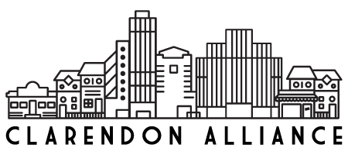
Clarendon Alliance New Board Member Orientation
May 8, 2016

Slide 2
Purposes of the CA in our Articles of Incorporpation
“…fostering the development, redevelopment and revitalization of …Clarendon… as defined in the Clarendon Sector Plan…through the pursuit of the following principal goals:
Encouraging the physical development and redevelopment of the Clarendon area within the general guidelines of the Sector Plan;
Fostering the development of economically sound businesses—including, especially, a strong retail business community—in the Clarendon area;
Coordinating public and private expenditures for development and redevelopment in the Clarendon area so as to foster the development of Clarendon as a cohesive, magnetic business and residential location alive with offices, retail shops, residences and park that contribute to a pleasing and economically stable environment.”
  Note: We currently operate and support Courthouse, so an expansion of our boundaries has been under discussion by the board

Slide 3
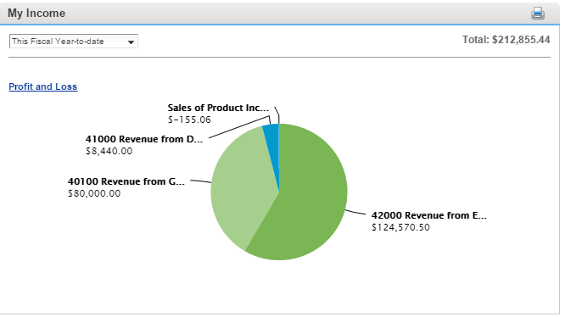
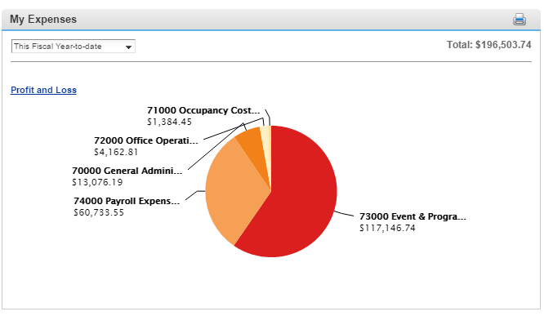
Our funding
Since our inception, we have been funded by:
  County Funding through a base “Partnership Grant” and through a County “Matching Grant”.
    Our current total is $80K in available grant dollars.
  Plus revenues we raise through memberships, ticket sales, and day-of-event income.

Slide 4
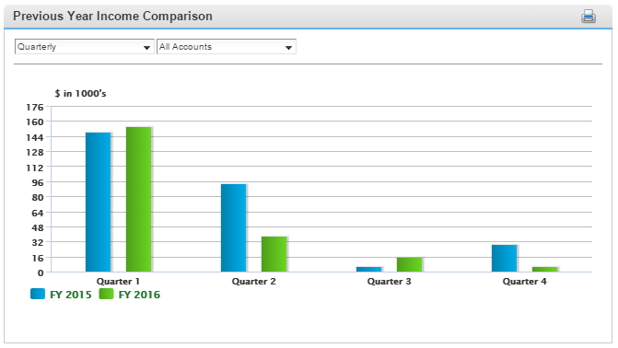
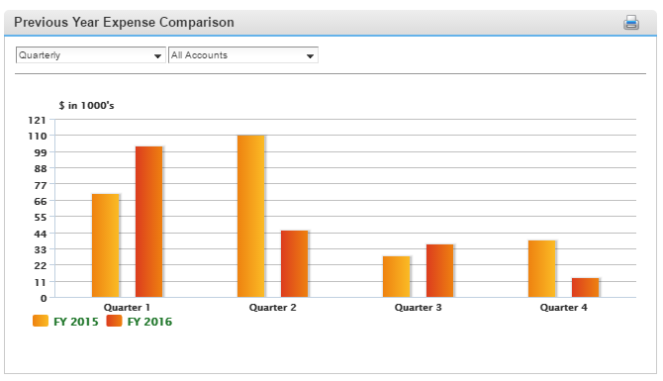
CA Funding Narrative
The CA operates on its cash flow.
We are eligible for our County Partnership Grant in July, after we submit our budget and workplan
In the first quarter, we qualify for our Matching Grant via Clarendon Day, plus any CD net income
In Q3, we can draw our Matching Grant. Expenses are Holiday Lights and Mardi Gras
In Q4, we have income from the Art Festival, Urban Village Market, and CD registrations
We bill for Memberships prior to our Annual Meeting, is held in Q3
Income and Expense varies due to our programming choices

Slide 5
Funding & Programming
All of Arlington’s BIDs and Partnerships do many of the same things…
But the funding resources are different for BIDs than Partnership orgs:
  Rosslyn BID - $3.56M
  Crystal City BID - $2.61M
  Ballston BID - $1.74M
Columbia Pike Revitalization Organization - $275K
Clarendon Alliance - $80K
Source: Guidestar and County information
Clarendon Alliance Programs FY 17
BeCause Festival – July test run
Clarendon Day – Sept
Holiday Lights – Nov
Mardi Gras Parade & Ball Feb/Mar
Arlington Art Festival – April
BeCause Festival – May (Courthouse location)
Bark in the Park – June
Urban Village Market
Clarendon Farmers Market

Slide 6
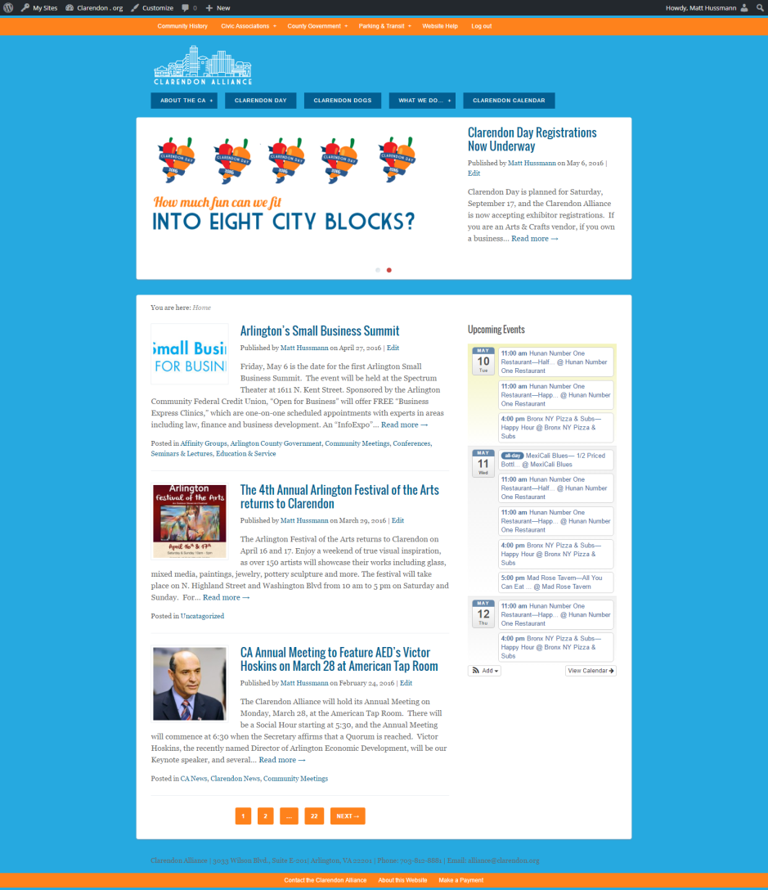
Technical Resources added in recent years
Wordpress Multisite
  7 sites for various activities
  Online registration and bill payments
  Clarendon Calendar
  Directory Plugin in progress

Slide 7
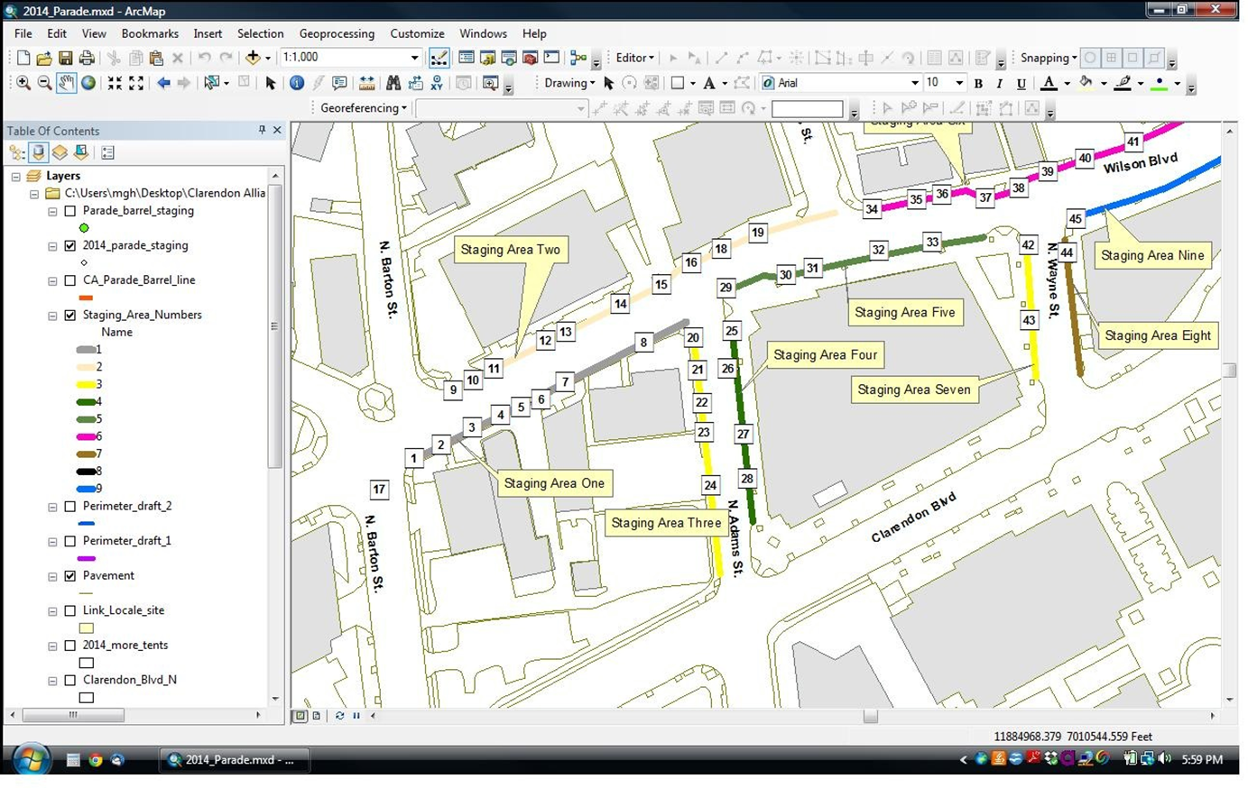
Technical Resources added in recent years
GIS for Events

Slide 8
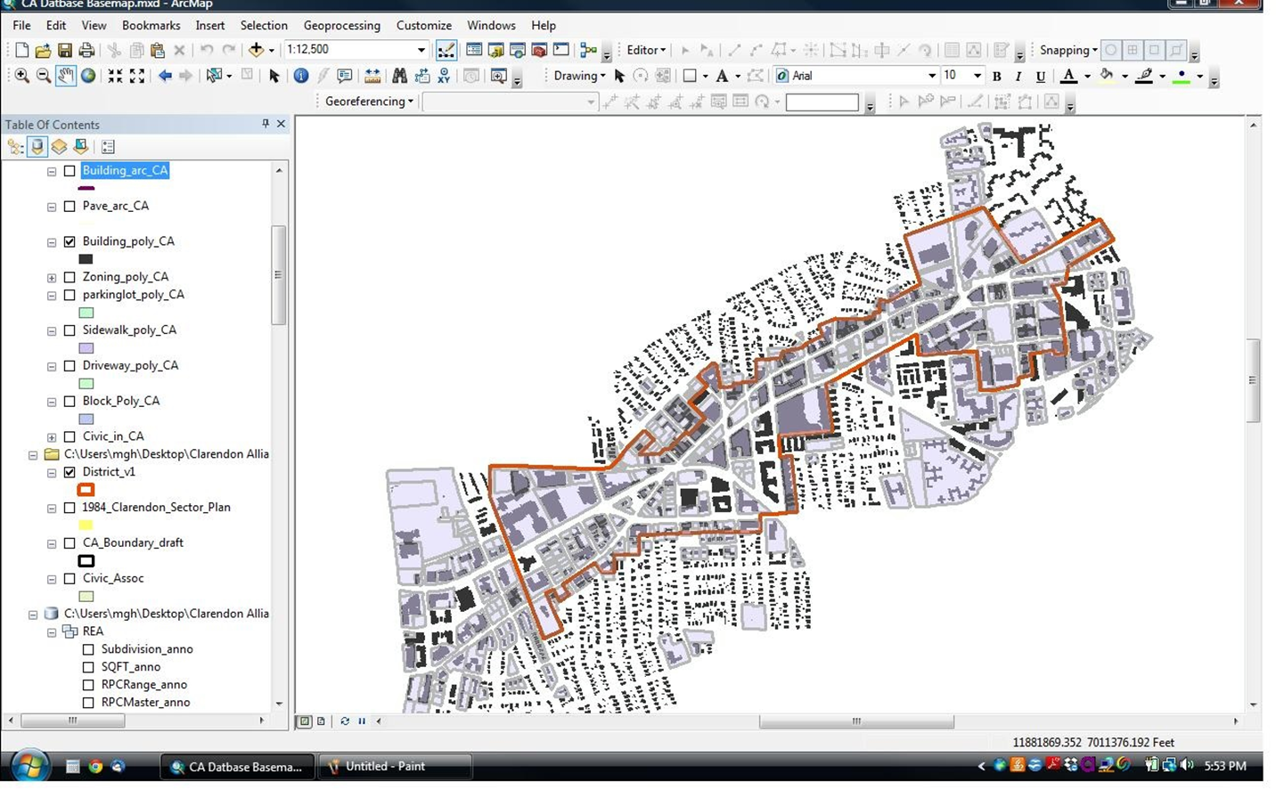
Technical Resources added in recent years
GIS for Analysis

Slide 9
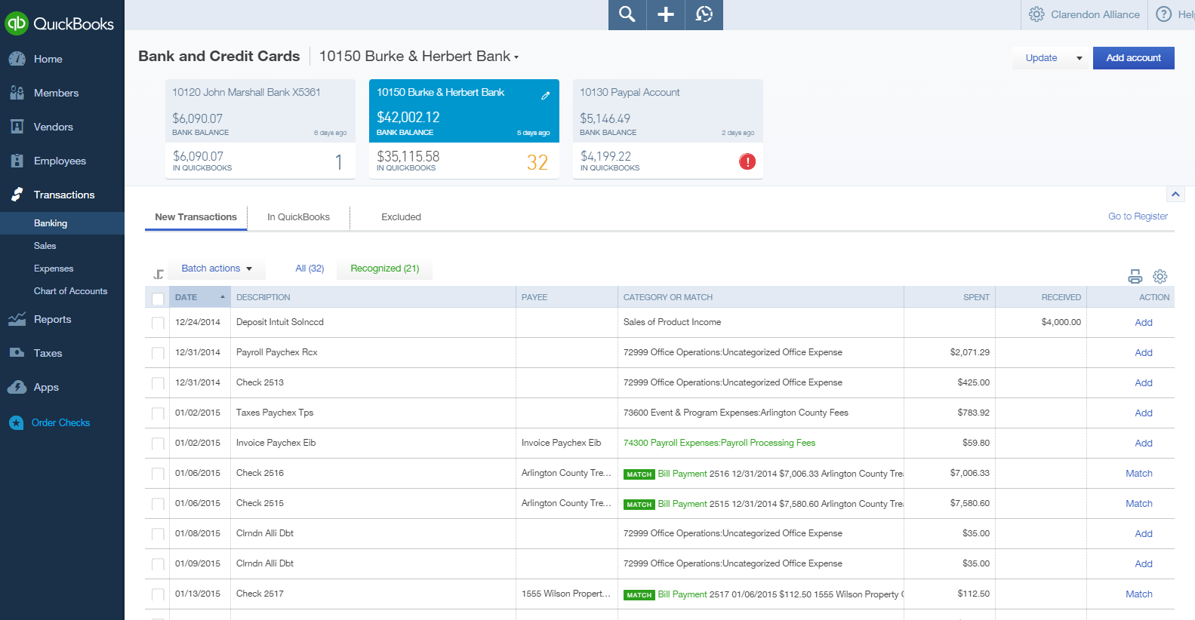
Technical Resources added in recent years
Quickbooks Online

Slide 10
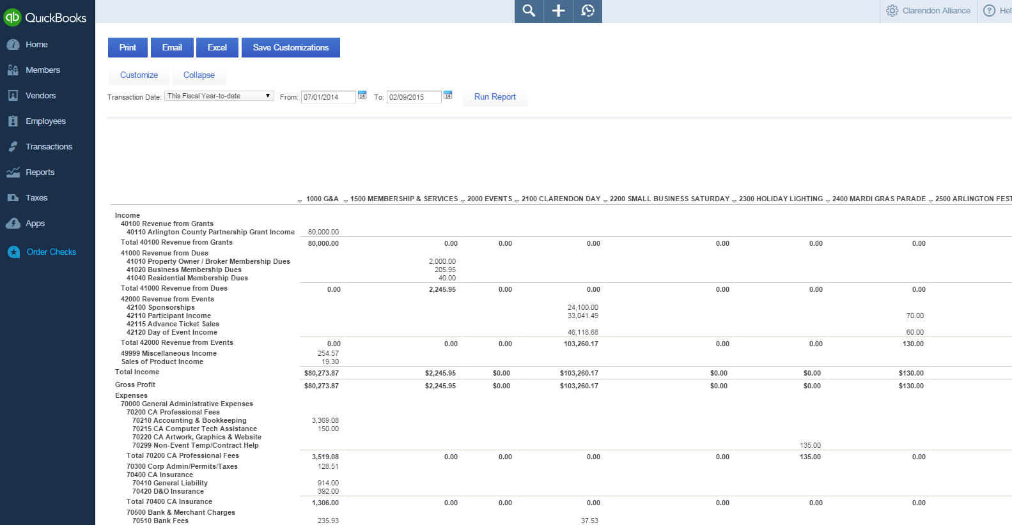
QBO P/L by Class Report

Slide 11
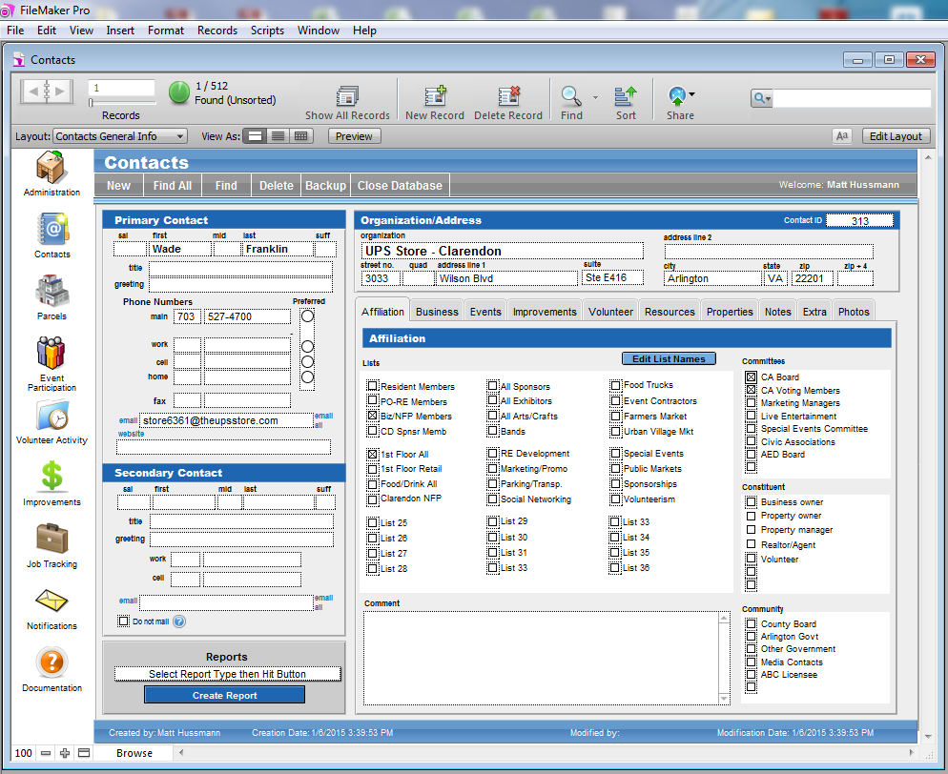
CA Database (in process)*

Slide 12
Upcoming issues for Board
Staff Performance Review
Draft and approve work plan (May)
Draft and approve budget (June)
Other issues…
    Office space for the CA
    Clarendon Farmers Market continuation
    Integration/coordination with Clarendon Business Association
Longer term issues the board has discussed
    Expansion of CA District through AED & County Board
    501(c)(3) status for CA
    Exploration of establishing a BID in Clarendon

Slide 13
Summary
Strengths of the CA
Weaknesses of the CA
Well-established organization
Very experienced board members
Experienced staff
Improved event calendar
Improved technology
A strong district in which to work
Good relations with County government
Poor public visibility
  No office for past two years
Declining paid membership
  Problem for CPRO & CA
Business community suspicion
  Clarendon Business Association for restaurants
Poor public participation in CA
  No office limits volunteer & community involvement
Limited financial resources
Limited staff time

